Slide 1
Sparse Autoencoder Architecture
Pre-computed, not available during training
Input Layer
(d=256)
Hidden Layer
(d=512)
Output Layer
(d=256)
True Feature Matrix F
y=Fx
c=ReLU(Wy+b) (goal: c≈x)
z=Dc
Specific Feature Coefficients x
(positive, sparse)
Learned parameters: - matrix W - biases b - matrix D (goal: D≈F)
Sparsity loss term:
∥c∥_1
Reconstruction loss term:
∥z-y∥_2

Slide 2
Sparse Autoencoder Architecture
Input Layer
(d=128)
Hidden Layer
(d=J)
Output Layer
(d=128)
y
c=ReLU(Wy+b)
z=Dc
Hyperparameters:
α=0.001
J=256, 512, …, 8192
Sparsity loss term:
∥c∥_1
Reconstruction loss term:
∥z-y∥_2
Learned parameters: - matrix W - biases b - matrix D
Overall loss term:
∥z-y∥_2
+ α∥c∥_1

Slide 3
Sparse Autoencoder
Parameters
Hyperparameters:
α=0.001
J=256, 512, …, 8192
Learned parameters: - matrix W - biases b - matrix D
Input Layer (LM activations)
(d=128)
y
c=ReLU(Wy+b)
Sparsity loss term:
∥c∥_1
Loss
Hidden Layer
(d=J)
Overall loss term:
∥z-y∥_2
+ α∥c∥_1
z=Dc
Reconstruction loss term:
∥z-y∥_2
Output Layer
(d=128)

Slide 4
Unknowns
⋮
Measurables
⋮
Want to Find
True Feature Matrix F
True Feature Matrix F
Vector x_1
(positive, sparse)
y_1=Fx_1
?
Vector x_2
(positive, sparse)
y_2=Fx_2
Vector x_3
(positive, sparse)
y_3=Fx_3

Slide 5
MMCS(A, B) | B=Small dictionary | B=Right-size dictionary | B=Large dictionary
A=Small dictionary | Low (learned different combinations of features) | Low (learned combinations of features instead of true features) | Low (learned combinations of features instead of true features)
A=Right-size dictionary |  | High (both learn true features) | High (both learn true features, extraneous features ignored)
A=Large dictionary |  |  | Low (extraneous features bring down average)

Slide 6
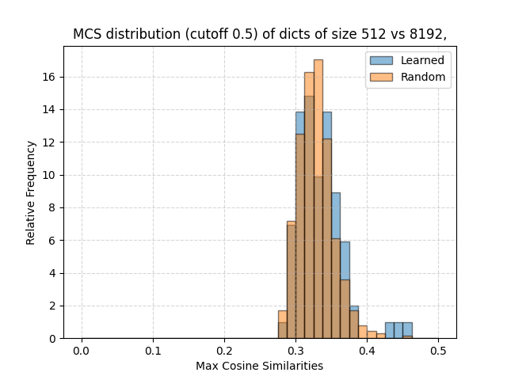
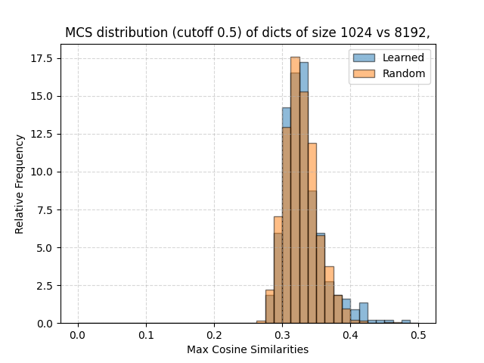
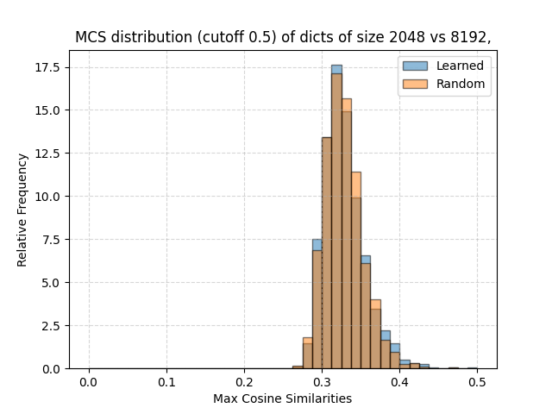
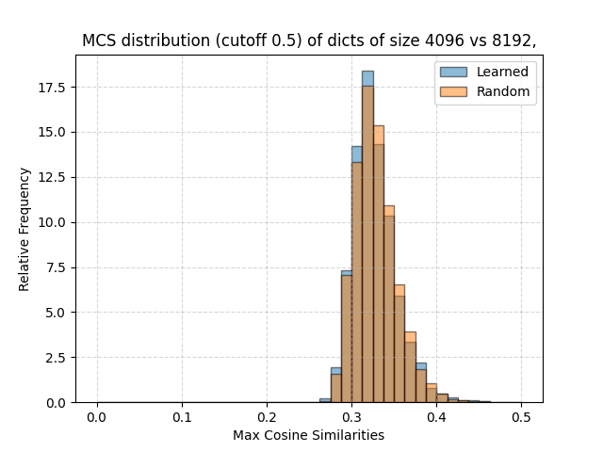

Slide 7
